Slide 1
Wireless Network
Introduction about Wireless Network connection
Confidential

Slide 2
Overview
Introduction.
Package Content.
Setup Wireless Network.
Configure WiFi.
Confidential

Slide 3


I. Introduction.
DirecTV receivers connected to the internet service allows customers to access the full breadth of DIRECTV features, including On Demand movies, Pandora Internet radio, YouTube.
The following receivers can all be connected via Ethernet:
  HR20, HR21, HR22, HR23, HR24
  HR34 Genie, HR44 Genie
  THR22 (TiVo)
  H21, H23, H24
Only HR44 platform has WiFi integration (built-in WiFi).
Confidential

Slide 4
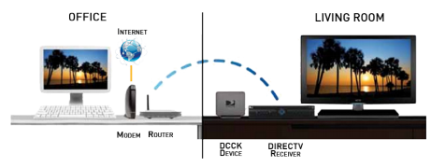
I. Introduction. (cont.)
There are 2 ways to connect to the customer's wireless router and the DIRECTV receiver or DIRECTV Whole-Home DVR service compatible network without any major wiring ran through the home.
  Use wireless adapter.
  Use Wireless DECA Cinema Connection Kit (CCK-W).
Confidential

Slide 5
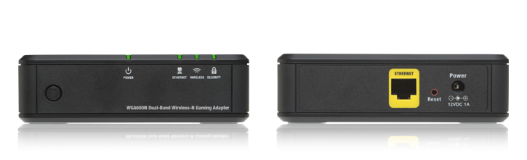
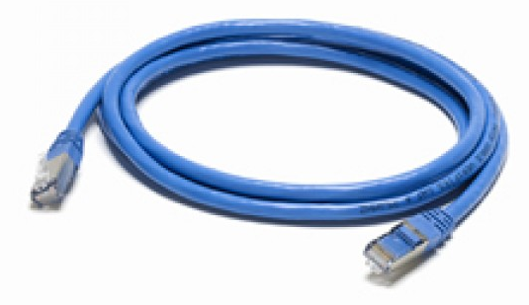
II. Package Content.
Wireless network adapter (WGA600N)
Ethernet cable.
Confidential

Slide 6
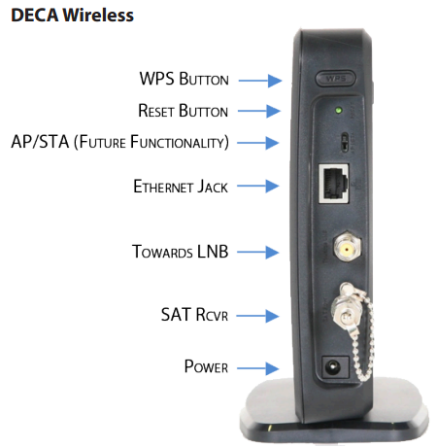
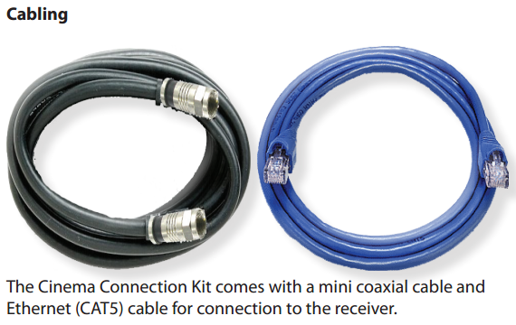
II. Package Content. (cont..)
Wireless Cinema Connection Kit
Confidential

Slide 7
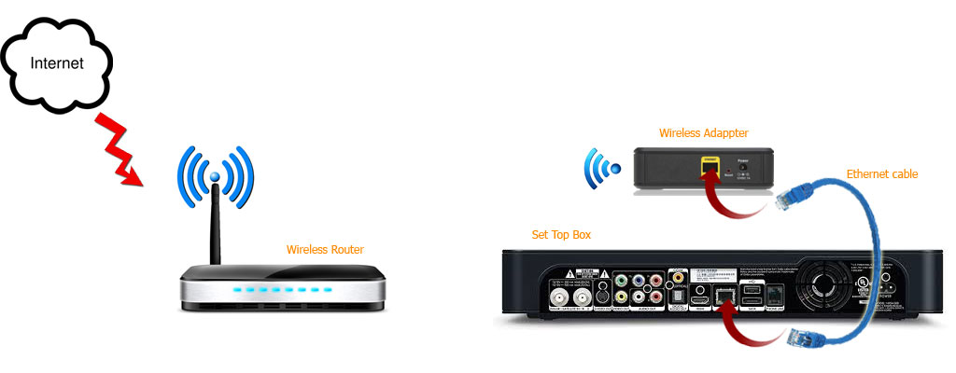
III. Setup Wireless Network
Create a wireless access point using wireless router.
Connect the wireless adapter onto the STB's Ethernet port directly.
* Notice that this model does not apply to built-in WiFi HR44
Confidential

Slide 8
IV. Configure WiFi
Non Built-in WiFi STB.
Built-in WiFi HR44.
Confidential

Slide 9
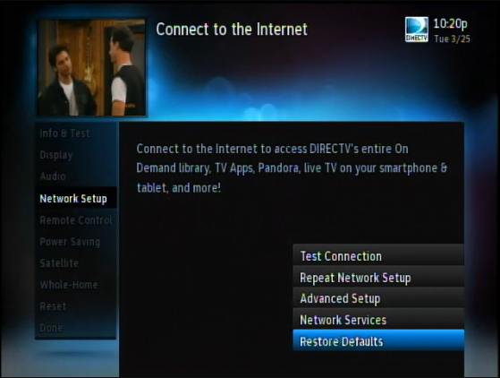
IV. Configure WiFi.
Non Built-in WiFi STB.
Follow these steps to get WiFi connection for your receiver.
  Press and hold the reset button of wireless adapter for 10 seconds till the amber light glows amber.
  From STB, access “Settings & Help”
  -> “Settings” -> “Network Setup”
  -> “Reset Defaults”
  Enter DASH (-) key.
  Press the EXIT button.
Confidential

Slide 10
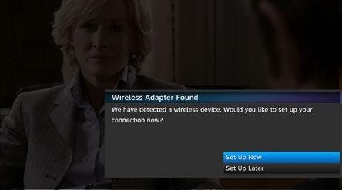
IV. Configure WiFi. (cont.)
Non built-in WiFi STB. (cont.)
  Connect wireless adapter to the STB via a network cable.
  Wait for OSD “Wireless adapter found” to appear.
  Select “Set Up Now” option.
Confidential

Slide 11
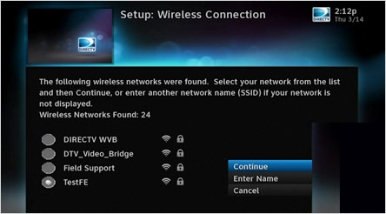
IV. Configure WiFi. (cont.)
Non Built-in WiFi STB. (cont.)
  On “Setup: Wireless Connection” screen. Choose an access point and select “Continue” option.
Confidential

Slide 12
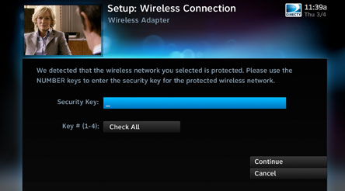
IV. Configure WiFi. (cont.)
Non Built-in WiFi STB. (cont.)
  Enter correct security key (also called wireless password, wireless key, etc) and continue.
  Select “Connect Now” on “Setup: Wireless Connection” screen.
Confidential

Slide 13
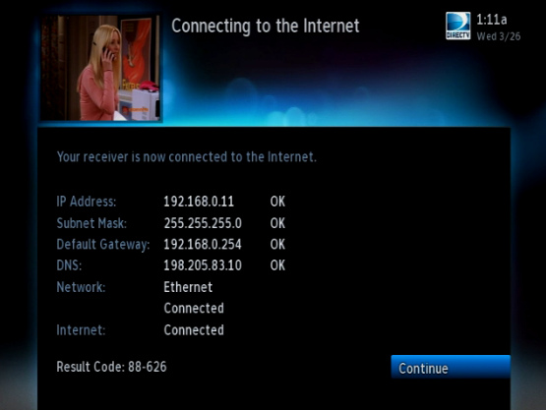
IV. Configure WiFi. (cont.)
Non Built-in WiFi STB. (cont.)
  On the next screen, if result code is 88-XXX, it means your receiver is connected to the Internet successfully.
Confidential
Notes:
Your receiver is connected to DIRECTV via the Internet. This is a completion code, not a failure code, and indicates that the receiver has successfully connected to the Internet and the DIRECTV Server.

Slide 14
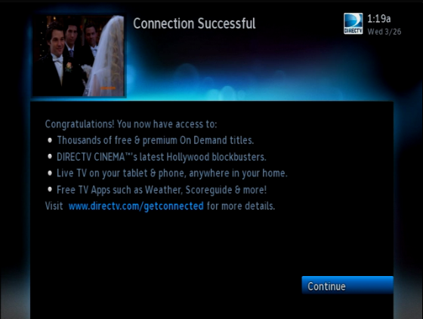
IV. Configure WiFi. (cont.)
Non Built-in WiFi STB. (cont.)
  Select “Continue” twice to finish.
Confidential

Slide 15
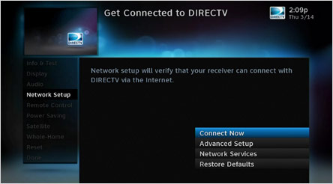
IV. Configure WiFi. (cont.)
Built-in WiFi HR44.
Because HR44 platform has built in WiFi, Wireless Adapter is not used in this case. Just disconnect the wired network cable from the HR44 and follow these steps to get WiFi connection.
  From STB, access “Settings & Help”
  -> “Settings” -> “Network Setup”
  -> “Connect Now”.
  Wait for the next screen appears.
Confidential

Slide 16
IV. Configure WiFi. (cont.)
Built-in WiFi HR44. (cont.)
  “Equipment List: Wireless Connection” screen appears. Select “Continue” option.
  If your router supports WiFi Protected Setup (WPS), select “Push Button Setup” option, otherwise select “Manual Setup” option.
  Select an access point then continue.
Confidential

Slide 17
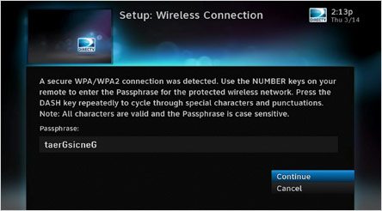
IV. Configure WiFi. (cont.)
Built-in WiFi HR44. (cont.)
  Enter correct security key in “Passphrase” then continue.
  Wait for “Connection Successful” screen to appears with code 88-XXX. Select “Finish” option to finish.
Confidential

Slide 18

Thank you
Confidential

